Slide 1
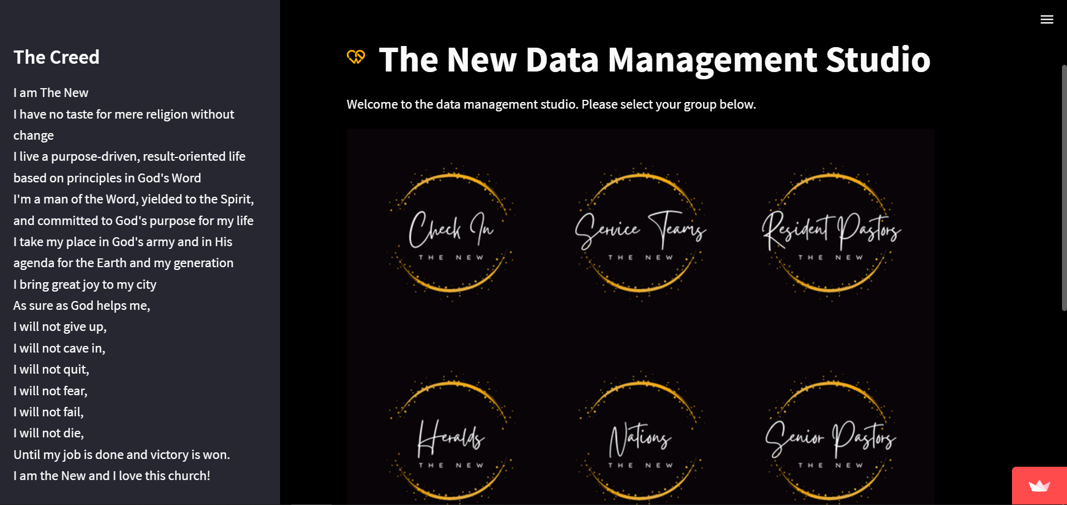
Heralds User Manual
Access the portal through https://bit.ly/TheNewDataOps
Works best on a PC; limited functionality on mobile.

Slide 2
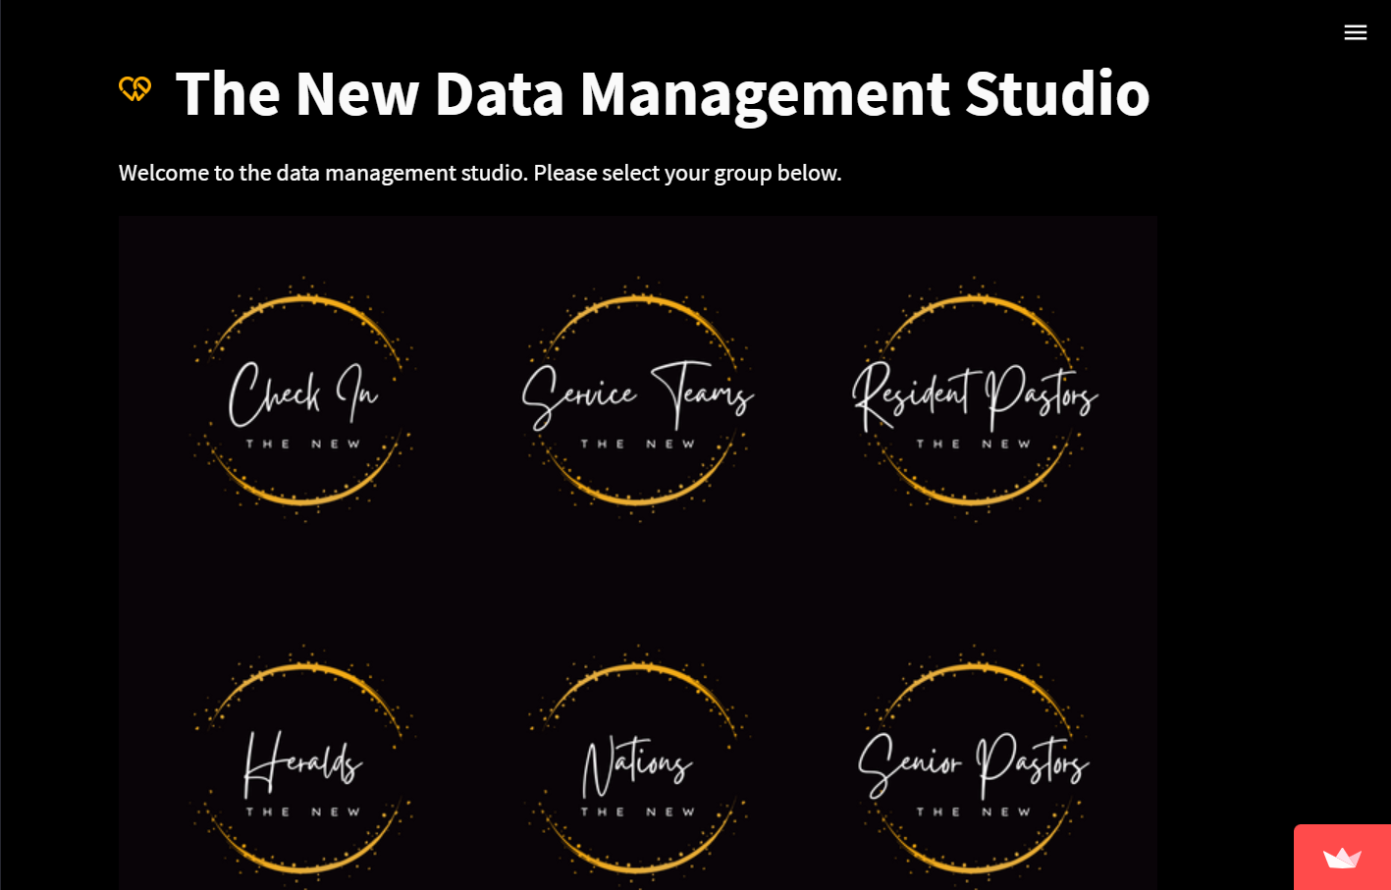
Click on Heralds.
You will be directed to a portal that asks for your login credentials.

Slide 3
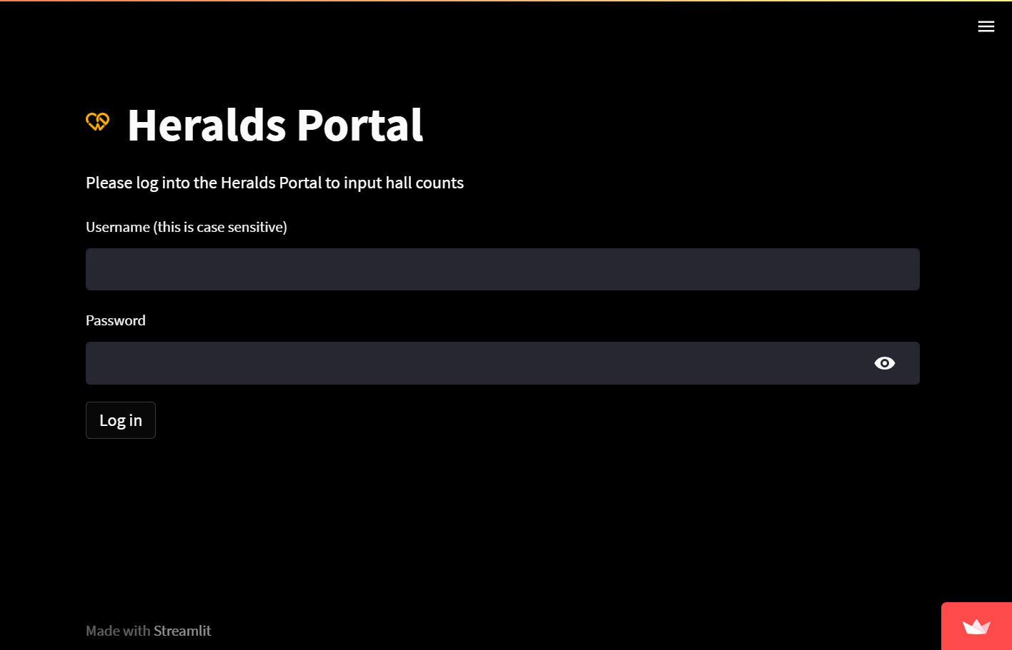
Click on Heralds.
You will be directed to a portal that asks for your login credentials.

Slide 4
Nation Pastors

Slide 5
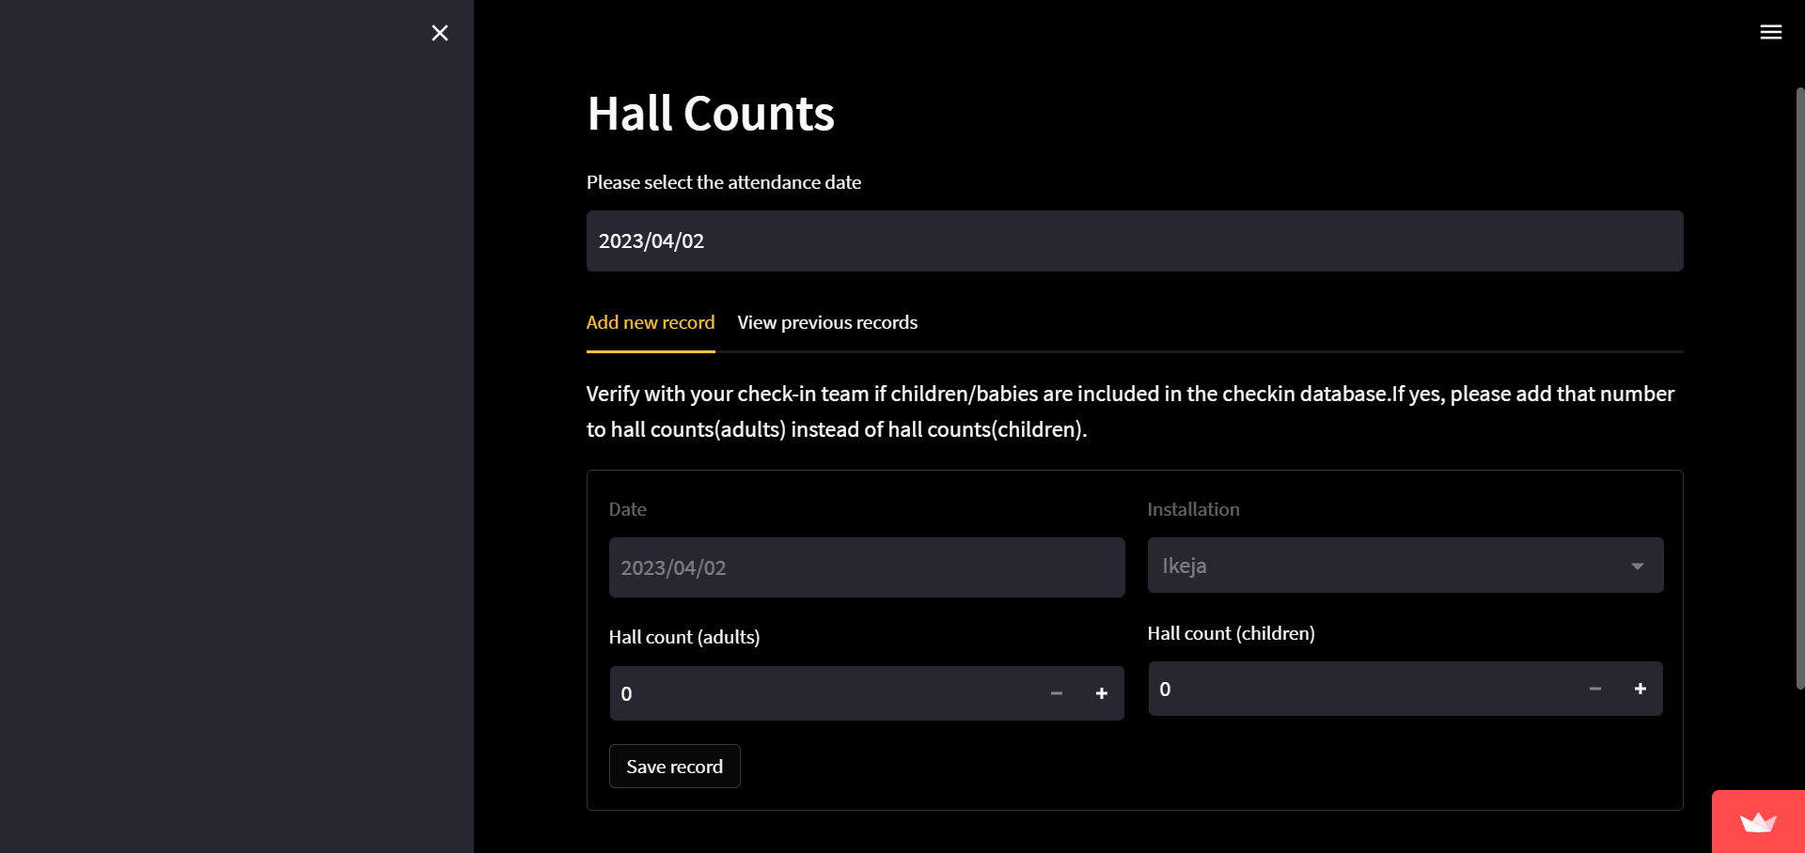
First, select a date that corresponds to a Sunday.
There are two tabs: one to add new records and another to see previous records.
In the Add new record tab, fill in the hall count for the day.
If children are excluded from the check-in database, please count them separately in the hall count children input tab.
Click on save table after your session to save the record.
Tab Options:
Add new record
date
save

Slide 6
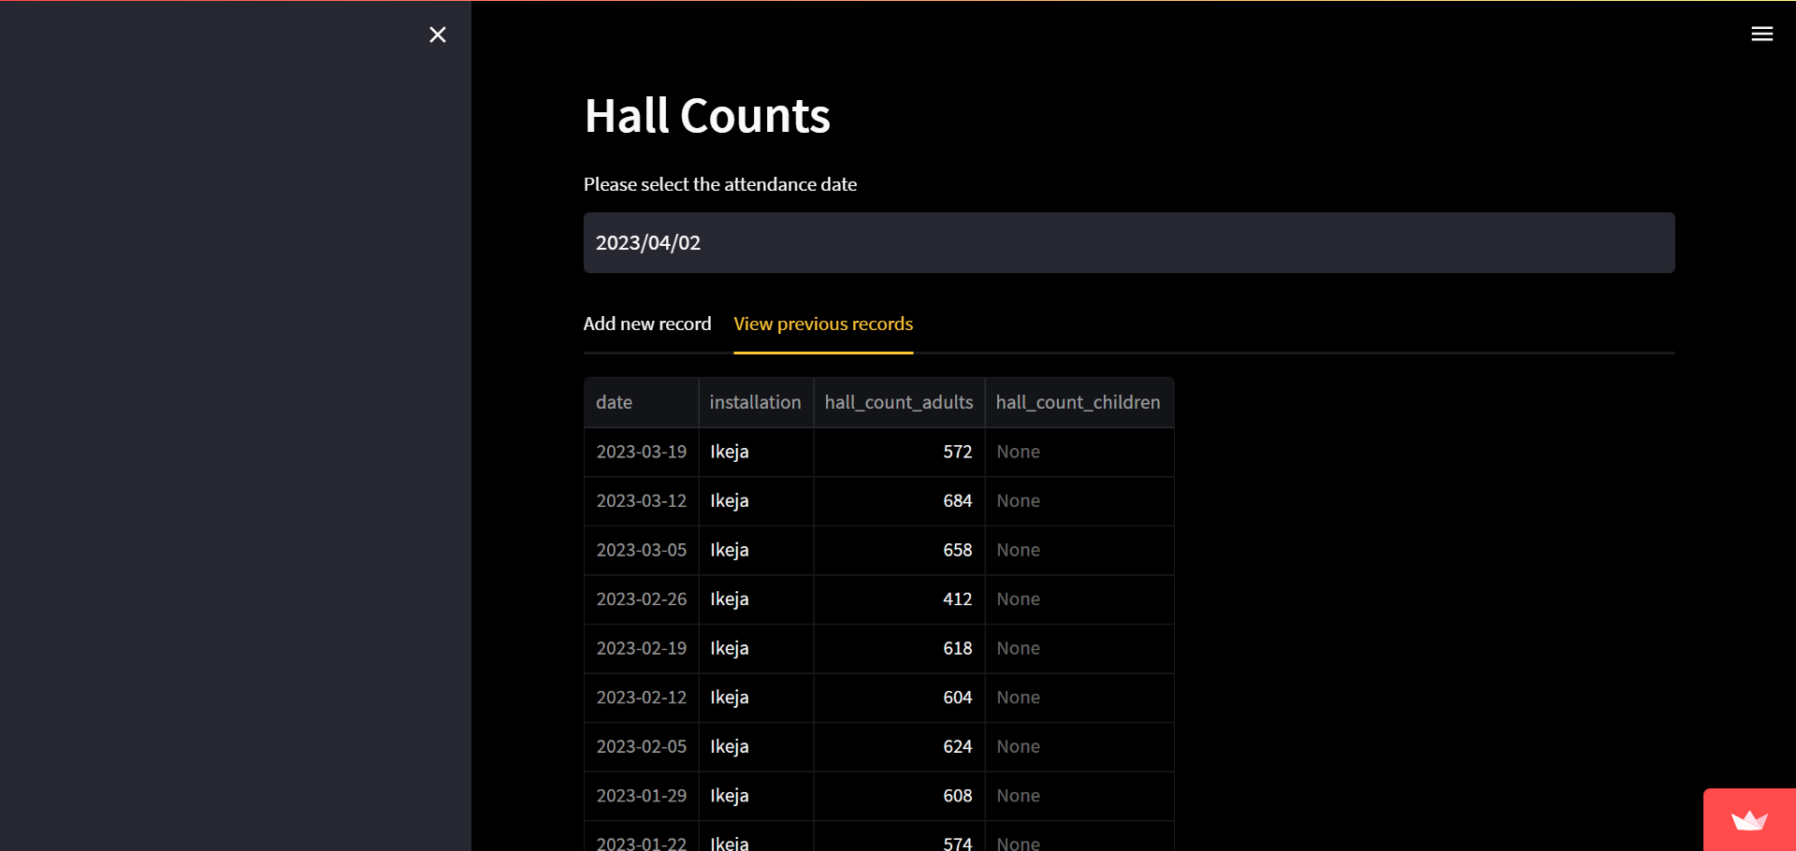
First, select a date that corresponds to a Sunday.
There are two tabs: one to add new records and another to see previous records.
In the View previous records tab, you can see previous entries from your installation’s hall count.
Tab Options:
Add new record
date

Slide 7
Login Credentials

Slide 8
Universal Password is: untilmyjobisdone
Username | Team
Yetunde | Heralds Ikeja

Slide 9
Thank You

